Slide 1

Chapter 11
Managing the New Product Development Process
Strategic Management of Technological Innovation, 7th Edition
Melissa A. Schilling
© McGraw Hill LLC. All rights reserved. No reproduction or distribution without the prior written consent of McGraw Hill LLC.

Slide 2
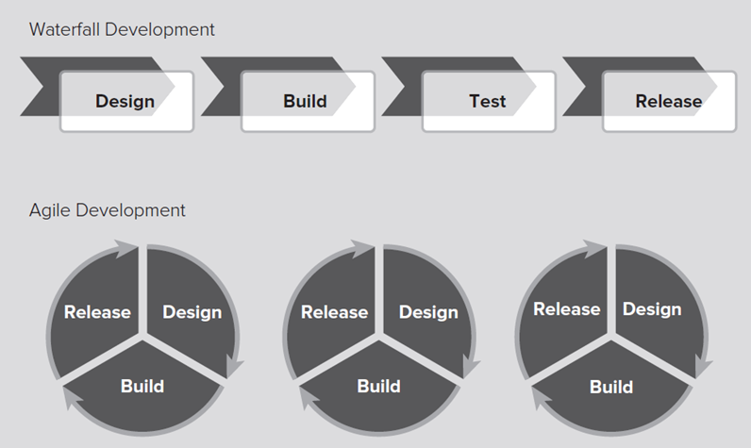
Scrums, Sprints, and Burnouts: Agile Development at Cisco Systems 1
Cisco Systems had long used a “waterfall” method to develop its software where teams moved through stages of the development process sequentially, often taking 18 months or more.
In 2014 they decided to try an agile development process, whereby a product is broken up into many smaller parts or features that are built by autonomous teams and released quickly, enabling developers to get feedback and fix bugs early.
Access the text alternative for these images.

Slide 3
Scrums, Sprints, and Burnouts: Agile Development at Cisco Systems 2
Product owner – represents customer’s interests and assembles complete list of functions to be developed.
“User stories” – short descriptions of desired functions described by customers in their own words.
Product backlog – the list of functions to be developed.
Sprints – two-week periods in which small sets of features from product backlog are developed and tested.
Scrum teams – small, self-organizing teams with no titles or manager that do the development.
Scrum master – a person who acts as a coach for multiple scrum teams, guiding scrum process (but not solutions).
Minimum viable product (M V P) – work that can be demonstrated to client for feedback.
Burndown chart – shows the amount of work remaining in sprint or product release and whether its on schedule.

Slide 4
Scrums, Sprints, and Burnouts: Agile Development at Cisco Systems 3
In agile development, rather than having grand comprehensive product redesigns, the product is constantly, incrementally adapted. Introducing small changes one or a few at a time helps to reduce risk, and also improves transparency about what works and what does not work.
For this approach to work a product has to be fairly modular, that is, it must be possible for a large product to be broken down into many smaller, relatively independent problems that can be worked on separately.
In the right setting agile development can accelerate product development, improve customer satisfaction, and improve employee satisfaction by giving them much more autonomy and a sense of ownership in their jobs.

Slide 5
Scrums, Sprints, and Burnouts: Agile Development at Cisco Systems 4
Discussion Questions.
What are some of the advantages and disadvantages of the agile development process?
How is agile development similar to or different from (a) the stage-gate process and (b) the parallel development process described in the chapter?
What are some of the likely changes agile development requires in managing development personnel?
What kinds of projects do you think agile development is appropriate for? What kinds of projects do you think it might be inappropriate for?

Slide 6
Overview
Despite the intense attention paid to innovation, failure rates are still very high.
More than 95% of new product development projects fail to earn an economic return.
This chapter summarizes research on how to make new product development more effective and efficient.

Slide 7
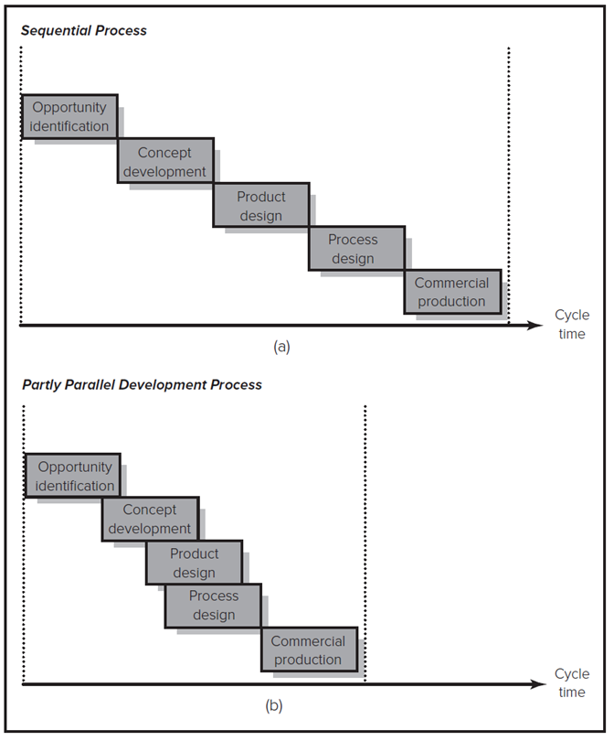
Sequential versus Party Parallel Development Processes
Before mid-19 90s, most U S companies used sequential N P D process; now many use partly parallel process.
Partly parallel process shortens overall development time and enables closer coordination between stages.
In some situations, however, a parallel development process can increase risks.
Access the text alternative for these images.

Slide 8
Project Champions
68% of North American firms, 58% of European firms, and 48% of Japanese firms report using senior executives to champion their N P D projects.
Benefits of Championing.
Senior execs have power to fight for project.
They can gain access to resources.
They can communicate with multiple areas of firm.
Risks of Championing.
Role as champion may cloud judgment about project.
May suffer from escalating commitment.
Others may fear challenging senior executive.
May benefit firm to develop “anti champions” and encourage expression of dissenting opinion.

Slide 9
Theory In Action 1
The Development of Zantac.
In the 19 70s, David Jack of Glaxo Holdings began working on an ulcer drug. Unfortunately, SmithKline Beecham beat Glaxo to market, introducing Tagamet in 19 77.
Jack decided to introduce an improved product and implemented the first parallel process in pharmaceuticals to beat Merck and Eli Lilly to market. The compressed development process would shorten development time but was also expensive and risky.
Fortunately, Paul Girolami, Glaxo’s director of finance, chose to champion the project, and encouraged Jack to develop improvements to the product which would differentiate it.
By 19 87, Glaxo’s Zantac was outselling Tagamet. Jack and Girolami were knighted, and Girolami became Glaxo’s chairman.

Slide 10
Research Brief 1
Five Myths About Product Champions.
Markham and Aiman-Smith argue that a number of myths have become widely accepted about champions.
Myth 1: Projects with champions are more likely to be successful in the market (many factors determining market success are typically beyond champion’s control).
Myth 2: Champions get involved because they are excited about project rather than from self-interest (results suggest that champions more likely to support projects that benefit their own departments).
Myth 3: Champions are more likely to be involved with radical innovation projects (equally likely to be involved with incremental projects).
Myth 4: Champions are more likely to be from high (low) levels in firm (either is equally likely).
Myth 5: Champions are more likely to be from marketing (15% from R&D, 14% from marketing, rest were from other functions or were users).

Slide 11
Involving Customers and Suppliers in the Development Process 1
Involving Customers.
Customer is often best able to identify the maximum performance capabilities and minimum service requirements of new product.
Customers may be involved on N P D team.
Firms may also use beta testing to get customer input early in the development process.
In agile development processes, individual features or functionalities are developed into minimum viable products and presented to customers for feedback.
Some studies suggest that it is more valuable to use “lead users” than a random sample of customers.
Lead users: Customers who face the same general needs of marketplace but experience them earlier than rest of market and benefit disproportionately from solutions.

Slide 12
Involving Customers and Suppliers in the Development Process 2
Crowdsourcing.
Firms can also open up an innovation task to the public through crowdsourcing, where people voluntarily contribute their ideas or effort. Platforms such as InnoCentive, Yet2.com, and TopCoder are well-known crowdsourcing sites.
Crowdsourcing challenges typically go through a four-step process:
Need Translation. A clear, concise and compelling need statement is articulated (for example, 1-2 page Request for Proposal).
Connecting. The innovation challenge is broadcasted to the network of potential solution providers.
Evaluation/Selection. Proposals reviewed in depth, and the most interesting are selected.
Acquisition. The firm engaged with the solution provider and negotiates an agreement to exchange knowledge, intellectual property, and compensation.

Slide 13
Research Brief 2
The Lead User Method of Product Concept Development.
Hilti A G used the lead user method to develop a new pipe hanger.
First customers with lead user characteristics were identified through phone interviews.
Lead users participated in a three-day product concept generation workshop. At end of workshop, a single design was selected as best.
Hilti then presented this design to 12 long-term customers; 10 of the 12 preferred the new design and 9 of the 10 were willing to pay a 20% price premium for it.
The lead user method reduced the cost and time of the project by almost half.

Slide 14
Involving Customers and Suppliers in the Development Process 3
Involving Suppliers.
Involving suppliers on N P D team or consulting as an alliance partner can improve product design and development efficiency.
Suppliers can suggest alternative inputs that reduce cost or improve functionality.

Slide 15
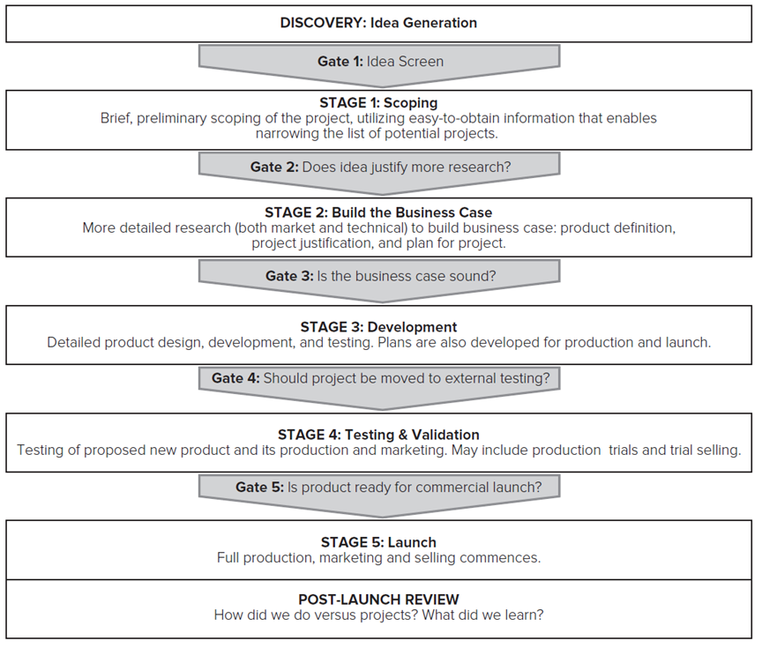
Tools for Improving the New Product Development Process 1
Stage-Gate Processes
Utilize tough go/kill decision points in the development process help filter out bad projects.
Source: R. G. Cooper, “Stage-Gate Idea to Launch System,” Wiley International Encyclopedia of Marketing: Product Innovation & Management 5, B. L. Bayus (ed.), (West Sussex UK: Wiley, 2011).
Access the text alternative for these images.

Slide 16
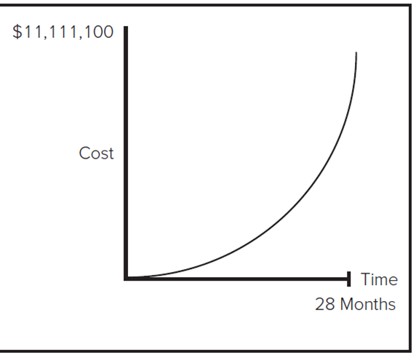
Tools for Improving the New Product Development Process 2
The time and cost of projects escalates with each stage, thus stage-gate processes only permit a project to proceed if all assessments indicate success.
Stage | Time | Cost
0. "Here's an idea!" | Blank | Blank
1. Formulate-describe and sketch | 1 week | $100
2. Conduct preliminary investigations | 2 weeks | $1,000
3. Design and define specifications | 1 month | $10,000
4A. Develop prototype and test | Blank | Blank
4B. Market research | Blank | Blank
4C. Strategic fit evaluation and N P V risk analysis | 2 months | $ 100,000
5A. Scale up, build pilot plant | Blank | Blank
5B. Market test | 8 months | $ 1 million
6A. Build plant | Blank | Blank
6B. Promote, launch, market | 16 months | $ 10 million
Source: R. G. Cooper, “Stage-Gate Idea to Launch System,” Wiley International Encyclopedia of Marketing: Product Innovation & Management 5, B. L. Bayus (ed.), (West Sussex UK: Wiley, 2011).
Access the text alternative for these images.

Slide 17
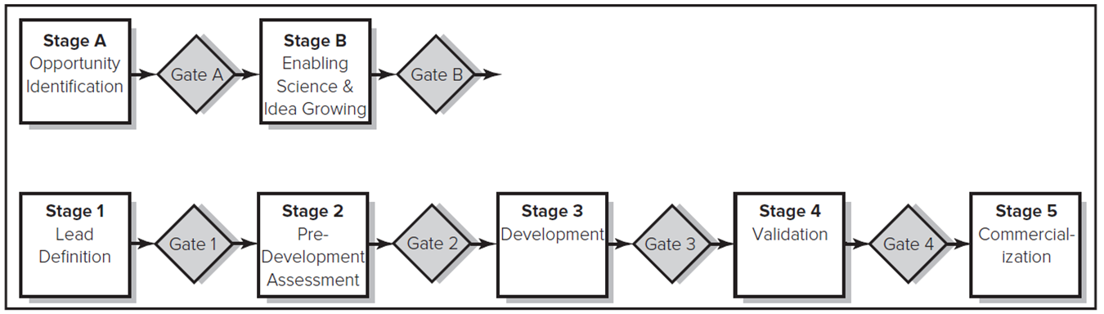
Tools for Improving the New Product Development Process 3
The stage-gate process can be modified to better fit a firm’s particular development needs.
For example, Exxon Research and Engineering’s stage-gate system.
Nearly 60% of firms use some type of stage-gate process to manage their N P D process.
Access the text alternative for these images.

Slide 18
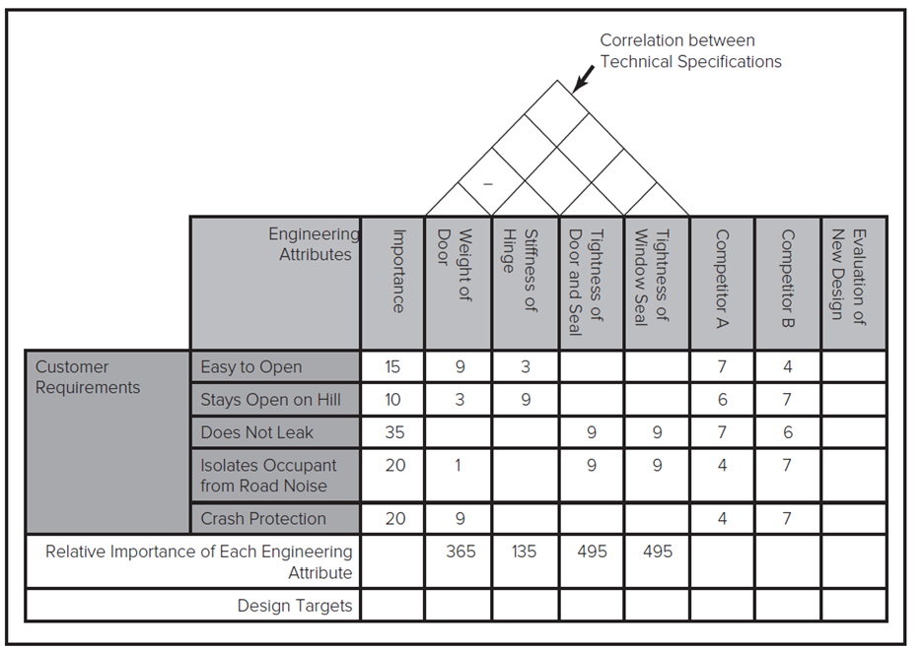
Quality Function Deployment (Q F D) – The House of Quality 1
Q F D improves communication and coordination between engineering, marketing, and manufacturing.
Access the text alternative for these images.

Slide 19
Quality Function Deployment (Q F D) – The House of Quality 2
Steps for Q F D.
Team identifies customer requirements.
Team weights requirements in terms of relative importance.
Team identifies engineering attributes that drive performance.
Team enters correlations between different engineering attributes.
Team indicates relationship between engineering attributes and customer requirements.
Team multiplies customer importance rating by relationship to engineering attribute and then sums for each attribute.
Team evaluates competition.
Using relative importance ratings for engineering attributes and scores for competing products, team determines design targets.
Team evaluates the new design based on the design targets.

Slide 20
Design for Manufacturing
Design for Manufacturing often involves a set of design rules that reduce cost and development time, while boosting quality.
Design Rule | Impact of Performance
Minimize the number of parts. | Simplifies assembly; reduces direct labor; reduces material handling and inventory costs; boosts product quality.
Minimize the number of part numbers (use common parts across product family). | Reduces material handling and inventory costs; improves economies of scale (increases volume through commonalty).
Eliminate adjustments. | Reduces assembly errors (increases quality); allows for automation; increases capacity and throughput.
Eliminate fasteners. | Simplifies assembly (increases quality); reduces direct labor costs; reduces squeaks and rattles; improves durability; allows for automation.
Eliminate jigs and fixtures. | Reduces line changeover costs; lowers required investment.

Slide 21
Failure Modes and Effects Analysis
F M E A is a method by which firms identify potential failures in a system, classify them according to their severity, and create a plan to prevent them.
Potential failure modes are evaluated on three criteria of risk: severity, likelihood, and inability of controls to detect the failure.
Each criteria is given a score (1-lowest, 5-highest).
Composite score is used to prioritize development efforts.

Slide 22
Computer-Aided Design/Computer-Aided Manufacturing
Computer-Aided Design (C A D) is the use of computers to build and test designs.
Enables rapid and inexpensive prototyping.
Computer-Aided Manufacturing (C A M) is the use of machine-controlled processes in manufacturing.
Increases flexibility by enabling faster changes in production set ups. More product variations can be offered at a reasonable cost.
Three-dimensional printing is where a design is printed by laying down thin horizontal strips of material until the model is complete.

Slide 23
Theory In Action 2
Computer-Aided Design of an America’s Cup Yacht.
Normally designing America’s Cup yachts required several months to develop smaller-scale models at a cost of $50,000 per prototype.
Using computer-aided design, Team New Zealand was able to consider many design specifications in a matter of hours at little cost, enabling more insight into design trade-offs.
Computer-aided design also avoided inaccurate results from using scaled-down prototypes.

Slide 24
Tools for Measuring New Product Development Performance 1
Measuring performance of N P D process can help company improve its innovation strategy and process.
Measures of N P D performance can help management:
identify which projects met their goals and why.
benchmark the organization’s performance compared to that of competitors, or to the organization’s own prior performance.
improve resource allocation and employee compensation, and.
refine future innovation strategies.
Important to use multiple measures to provide fair representation.

Slide 25
Tools for Measuring New Product Development Performance 2
New Product Development Process Metrics include:
What was the average cycle time (time-to-market) for development projects? How did this cycle time vary for projects characterized as breakthrough, platform, or derivative projects?
What percentage of development projects undertaken within the last five years met all or most of the deadlines set for the project?
What percentage of development projects undertaken within the last five years stayed within budget?
What percentage of development projects undertaken within the last five years resulted in a completed product?

Slide 26
Tools for Measuring New Product Development Performance 3
Overall Innovation Performance measures include:
What is the firm’s return on innovation? (This measure assesses the ratio of the firm’s total profits from new products to its total expeditures, including research and development costs, the costs of retooling and staffing production facilities, and initial commercialization and marketing costs.)
What is the percentage of projects that achieve their sales goals?
What percentage of revenues are generated by products developed within the last five years?
What is the firm’s ratio of successful projects to its total project portfolio?

Slide 27
Theory In Action 3
Postmortems at Microsoft.
At Microsoft, almost all projects receive postmortems reports.
Team will spend 3 to 6 months creating report.
Report will be anywhere from <10 pgs to >100 pgs.
Tend to be extremely candid and can be quite critical.
“The purpose of the document is to beat yourself up.”
Report describes team and development activities, product size, product quality, and evaluation of what worked well, what didn’t work well, and what group should improve.
Distributed to team and senior management.

Slide 28
Discussion Questions
What are some of the advantages and disadvantages of a parallel development process? What obstacles might a firm face in attempting to adopt a parallel process?
Consider a group project you have worked on at work or school. Did your group use mostly sequential or parallel processes?
Are there some industries in which a parallel process would not be possible or effective?
What kinds of people make good project champions? How can a firm ensure that it gets the benefits of championing while minimizing the risks?
Is the Stage-Gate process consistent with suggestions that firms adopt parallel processes? What impact do you think using Stage-Gate processes would have on development cycle time and development costs?
What are the benefits and costs of involving customers and suppliers in the development process?

Slide 29
End of Main Content
© McGraw Hill LLC. All rights reserved. No reproduction or distribution without the prior written consent of McGraw Hill LLC.

Slide 30
Accessibility Content: Text Alternatives for Images

Slide 31
Scrums, Sprints, and Burnouts: Agile Development at Cisco Systems 1 – Text Alternative
Return to parent-slide containing images.
Waterfall development shows four text boxes on four rightward arrows. From left to right, they read as follows: Design, build, test, and release. Agile development shows three illustrations in which design leads to build and release represented by sectors of three circles.
Return to parent-slide containing images.

Slide 32
Sequential versus Party Parallel Development Processes – Text Alternative
Return to parent-slide containing images.
The x axis shows cycle time. As time progresses, the sequential process dips from opportunity identification, concept development, product design, process design, to commercial production. As time progresses, the partly parallel development process dips from opportunity identification, concept development, product design, process design, to commercial production in a small interval.
Return to parent-slide containing images.

Slide 33
Tools for Improving the New Product Development Process 1 – Text Alternative
Return to parent-slide containing images.
The illustration is titled, discovery, idea generation. Gate 1: Idea screen points to stage 1 scoping that reads: Brief, preliminary scoping of the project, utilizing easy to obtain information that enables narrowing the list of potential projects. Gate 2: Does idea justify more research, points to stage 2: Build the Business Case. More detailed research, both market and technical, to build business case: product definition, project justification, and plan for project. Gate 3: Is the business case sound, points to stage 3: Development. Detailed product design, development, and testing. Plans are also developed for production and launch. Gate 4: Should project be moved to external testing, points to stage 4: Testing and Validation. Testing of proposed new product and its production and marketing. May include production trials and trial selling. Gate 5: Is product ready for commercial launch, points to stage 5: Launch. Full production, marketing and selling commences. Below it, is the post launch review that reads: How did we do versus projects? What did we learn?
Return to parent-slide containing images.

Slide 34
Tools for Improving the New Product Development Process 2 – Text Alternative
Return to parent-slide containing images.
The graph relates a cost of 11,111,100 dollars to time in 28 months. The graph represents that cost increases as time progresses. The table for stage, time, and cost reads as follows: 0. Here’s an idea! Blank. Blank. 1. Formulate describe and sketch, 1 week, 100 dollars. 2. Conduct preliminary investigations. 2 weeks. 1,000 dollars. 3. Design and define specifications. 1 month. 10,000 dollars. 4A. Develop prototype and test. Blank. Blank. 4B. Market research. Blank. Blank. 4C. Strategic fit evaluation and N P V. 2 months. 100,000 dollars. 5A. Scale up, build pilot plant. Blank. Blank. 5B. Market test. 8 months. 1 million dollars. 6A. Build plant. Blank. Blank. 6B. Promote, launch, market. 16 months. 10 million dollars.
Return to parent-slide containing images.

Slide 35
Tools for Improving the New Product Development Process 3 – Text Alternative
Return to parent-slide containing images.
Stage A, opportunity identification leads to gate A, that leads to Stage B, enabling science and idea growing, and stage B. Stage 1, lead definition leads to gate 1, stage 2, pre development assessment, gate 2, stage 3, development, gate 3, stage 4, validation, gate 4, and stage 5, commercialization.
Return to parent-slide containing images.

Slide 36
Quality Function Deployment (Q F D) – The House of Quality 1 – Text Alternative
Return to parent-slide containing images.
A table has column headers engineering attributes, importance, weight of door, stiffness of hinge, toughness of door and seal, tightness of window seal, competitor A, competitor B, and evaluation of new design. The row headers are grouped as customer requirements, that read: Easy to open, stays open on hill, does not leak, Isolates occupant from road noise, and crash protection. The entries in row 1, row 2, row 3, row 4, and row 5 read: 15, 9, 3, blank, blank, 7, 4, blank. 10, 3, 9, blank, blank, 6, 7, blank. 35, blank, blank, 9, 9, 7, 6, blank. 20, 1, blank, 9, 9, 4, 7, blank. 20, 9, blank, blank, blank, 4, 7, blank. The next row reads: Relative importance of each engineering attribute, blank, 365, 135, 495, 495, blank, blank, blank. The next row reads: Design targets, blank, blank, blank, blank, blank, blank, blank, blank.
Return to parent-slide containing images.

